Slide 1
Concepts of Social Geography:
Dr.M Sarma
Society and Environment: Social geography is essentially concerned with people in society.
Environment includes the physiographic elements of the earth’s surface, like relief, drainage, location, situation, etc. the climatic elements, the atmosphere including sunrays, the biotic elements both plants and animals and their activities and interaction with man. Society, on the other hand, is a group of people who live in the same environmental condition, work more or less for the same goal, follow same customs and traditions and strive to keep common interest. Thus, it is clear that the people of a society interact among themselves socially, culturally, economically and politically and their response to the environmental forces is same. Ex. Assamese society, Bengali society etc.

Slide 2
The ‘ecumene’ i.e. the habitable part of the earth, we see that in different parts different societies live under different environmental condition. For example-
  The equatorial forests have hunting, fishing, and food-gathering society.
  The tropical desert and savanas have pastoral nomadic society.
  The monsoon lands have sedentary society.
  The temperate lands have indusrtial society etc.
  The relationship between society and environment is vary from place to place and society to society. For ex. river that inundates its bank in the rainy season may be perceived as a boon by a peasant society, but it may not be so perceived by a hunting or a pastoral society.

Slide 3
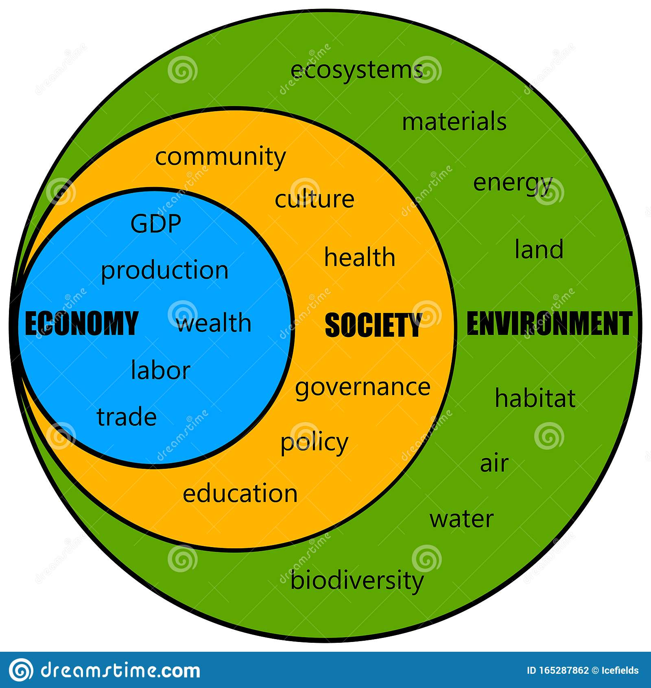

Slide 4
Relationship between Society and Environment
It is seen that physiography, climate, customs et. of man also vary from place to place . Geographers like Ellsworth Huntington believed that environment determines man’s economy, his material culture and even his thinking and religion. This philosophy is variously referred to as ‘Environmental determinism’ or simply ‘determinism’.
On the other hand, certain French geographers, headed by Vidal de La Blache, believe that the dictates of environment is not so much binding. According to them, environment presents man with a number of possible ways to live and carry out his economic activities. What way he chooses depends on his level of culture. This proposition is referred to as ‘possibilism’.

Slide 5
When we look into the ‘ecumene’ i.e. the habitable part of the earth, we see that in different societies live under different environmental conditions. The equatorial forests have hunting, fishing and food-gathering society, temperate lands have industrial society, etc. Some scholars look at each of these as a reflection of the environment as well as the concerned society’s respond to it.,

Slide 6
Influence of Environment on Man:
It is said that of all the environmental factors, climate is the most important in influencing society, for it not only determines his dress, house type, agricultural activities, food habit, etc. but also influences his health, physiology and capacity of sustained daily work.
Other element of environ are relief, grainage, flora and fauna. A coastal area, a plateau, a low lying flat plain, a desert or a mountain each influences the human activities in different ways.

Slide 7
